Slide 1
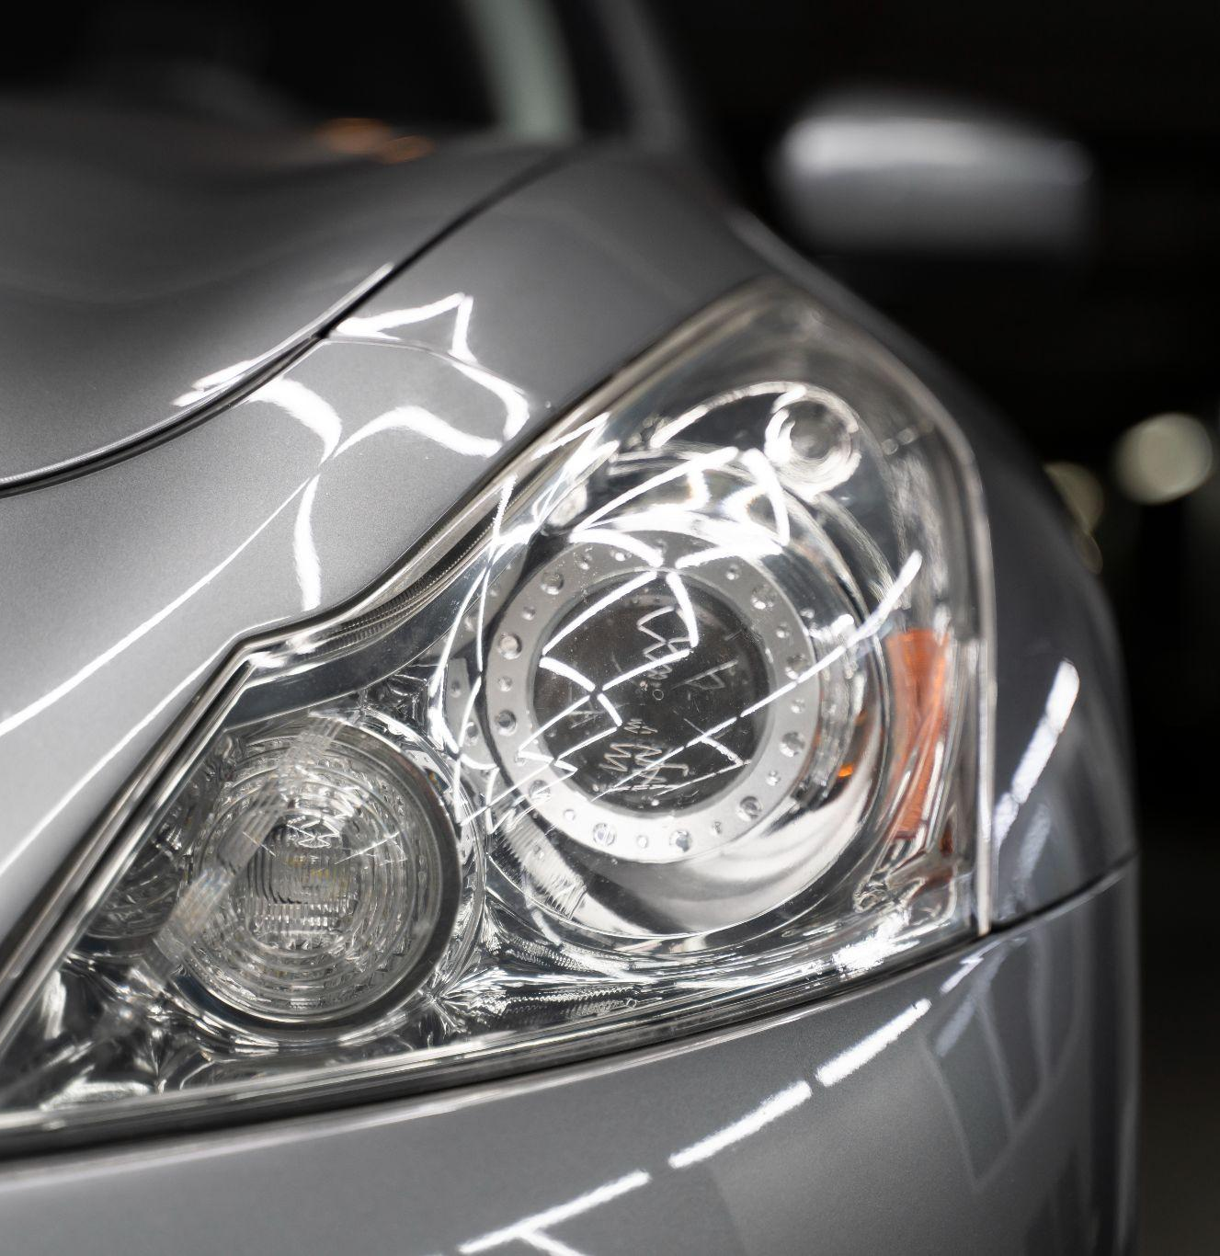
Parallel Parking
“
Avelabs Group: 2

Slide 2

Team Members:
Mohamed Salah
Esraa Ahmed
Huda Fouad
Shimaa Mahmoud
Mohamed Ismail

Slide 3
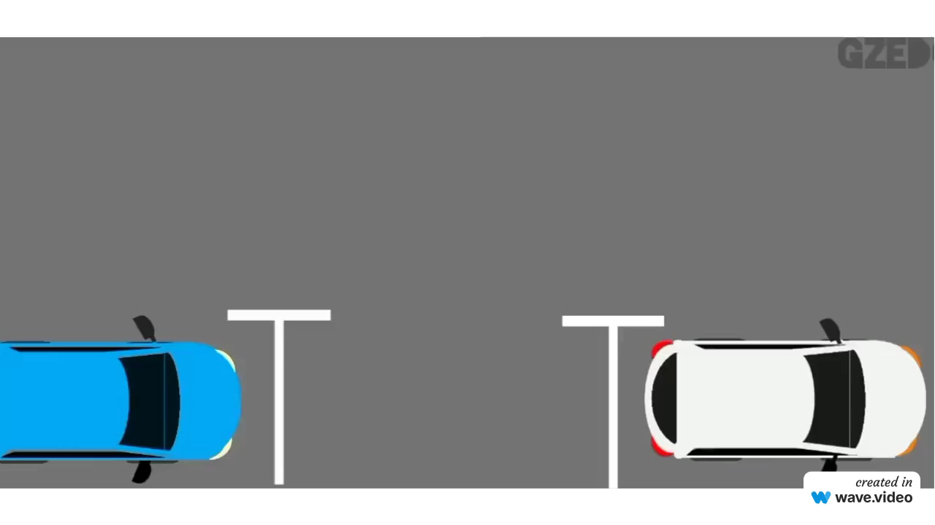

Slide 4
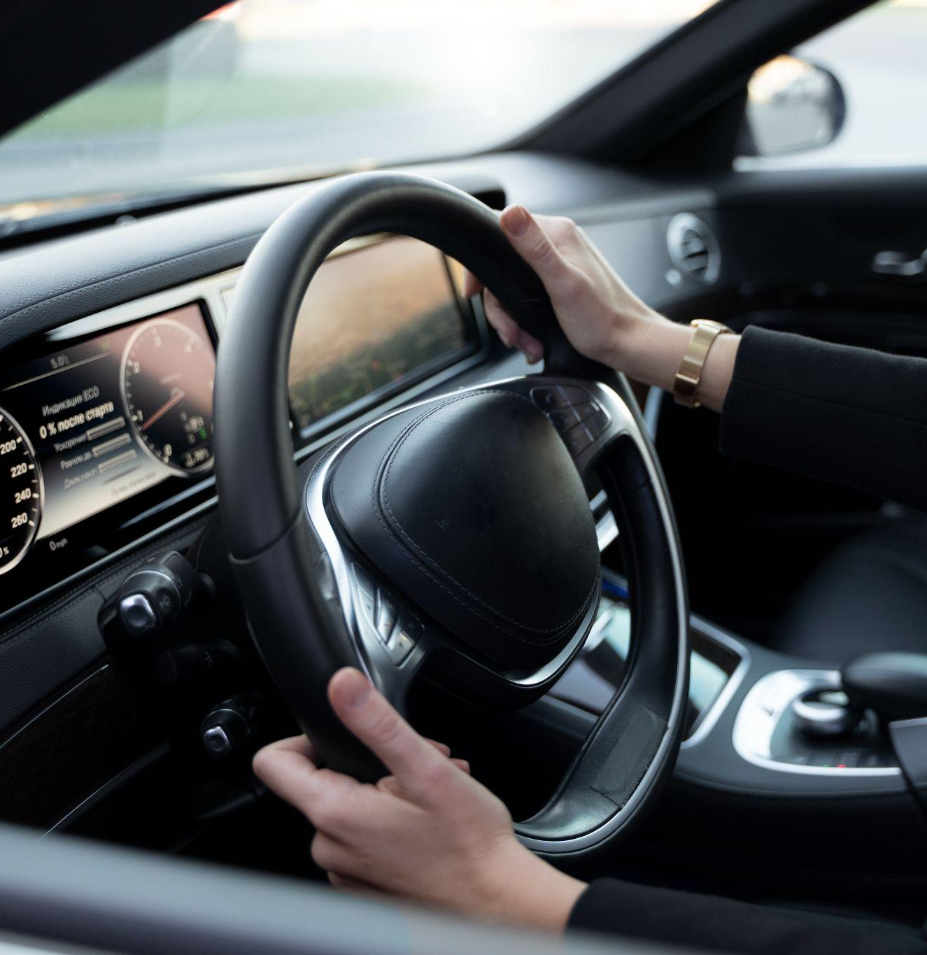
Hardware Requirment
AVR Microcontroller
4 Ultrasonic Sensors
2 Dc Motors
2 Battery 3.7volt
H Bridge
2 Leds & Buzzer
Car kit

Slide 5

Software Requirment
Timer in PWM Mode
Timer Used in ICU
DIO Module

Slide 6
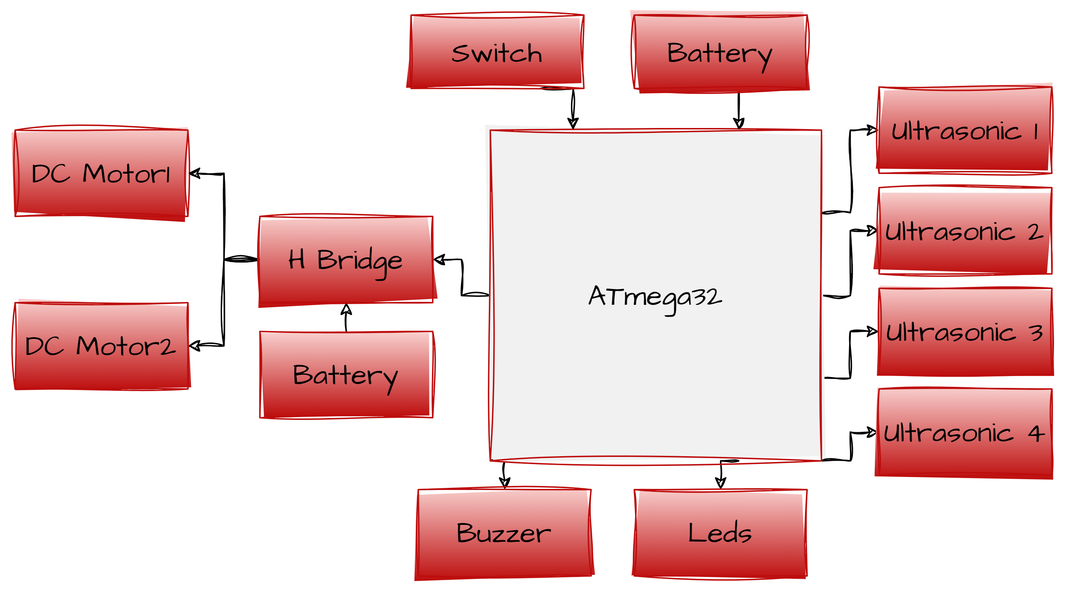
System Architecture

Slide 7
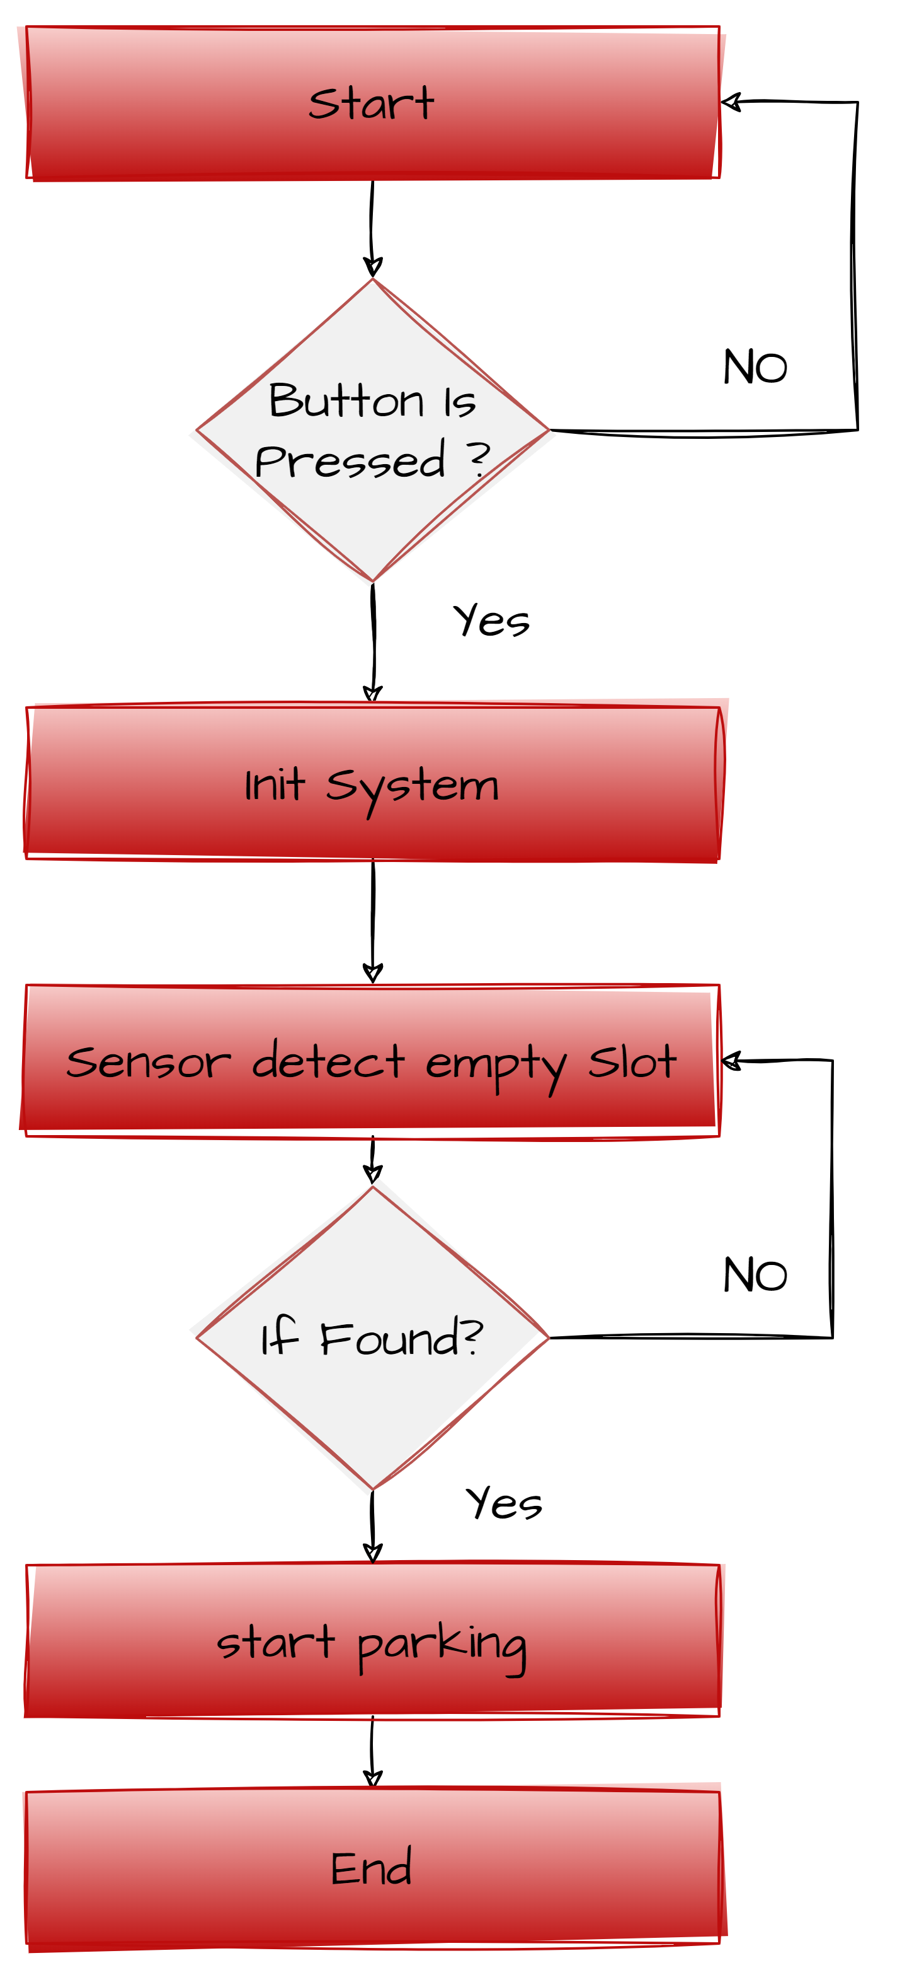
Flowchart

Slide 8
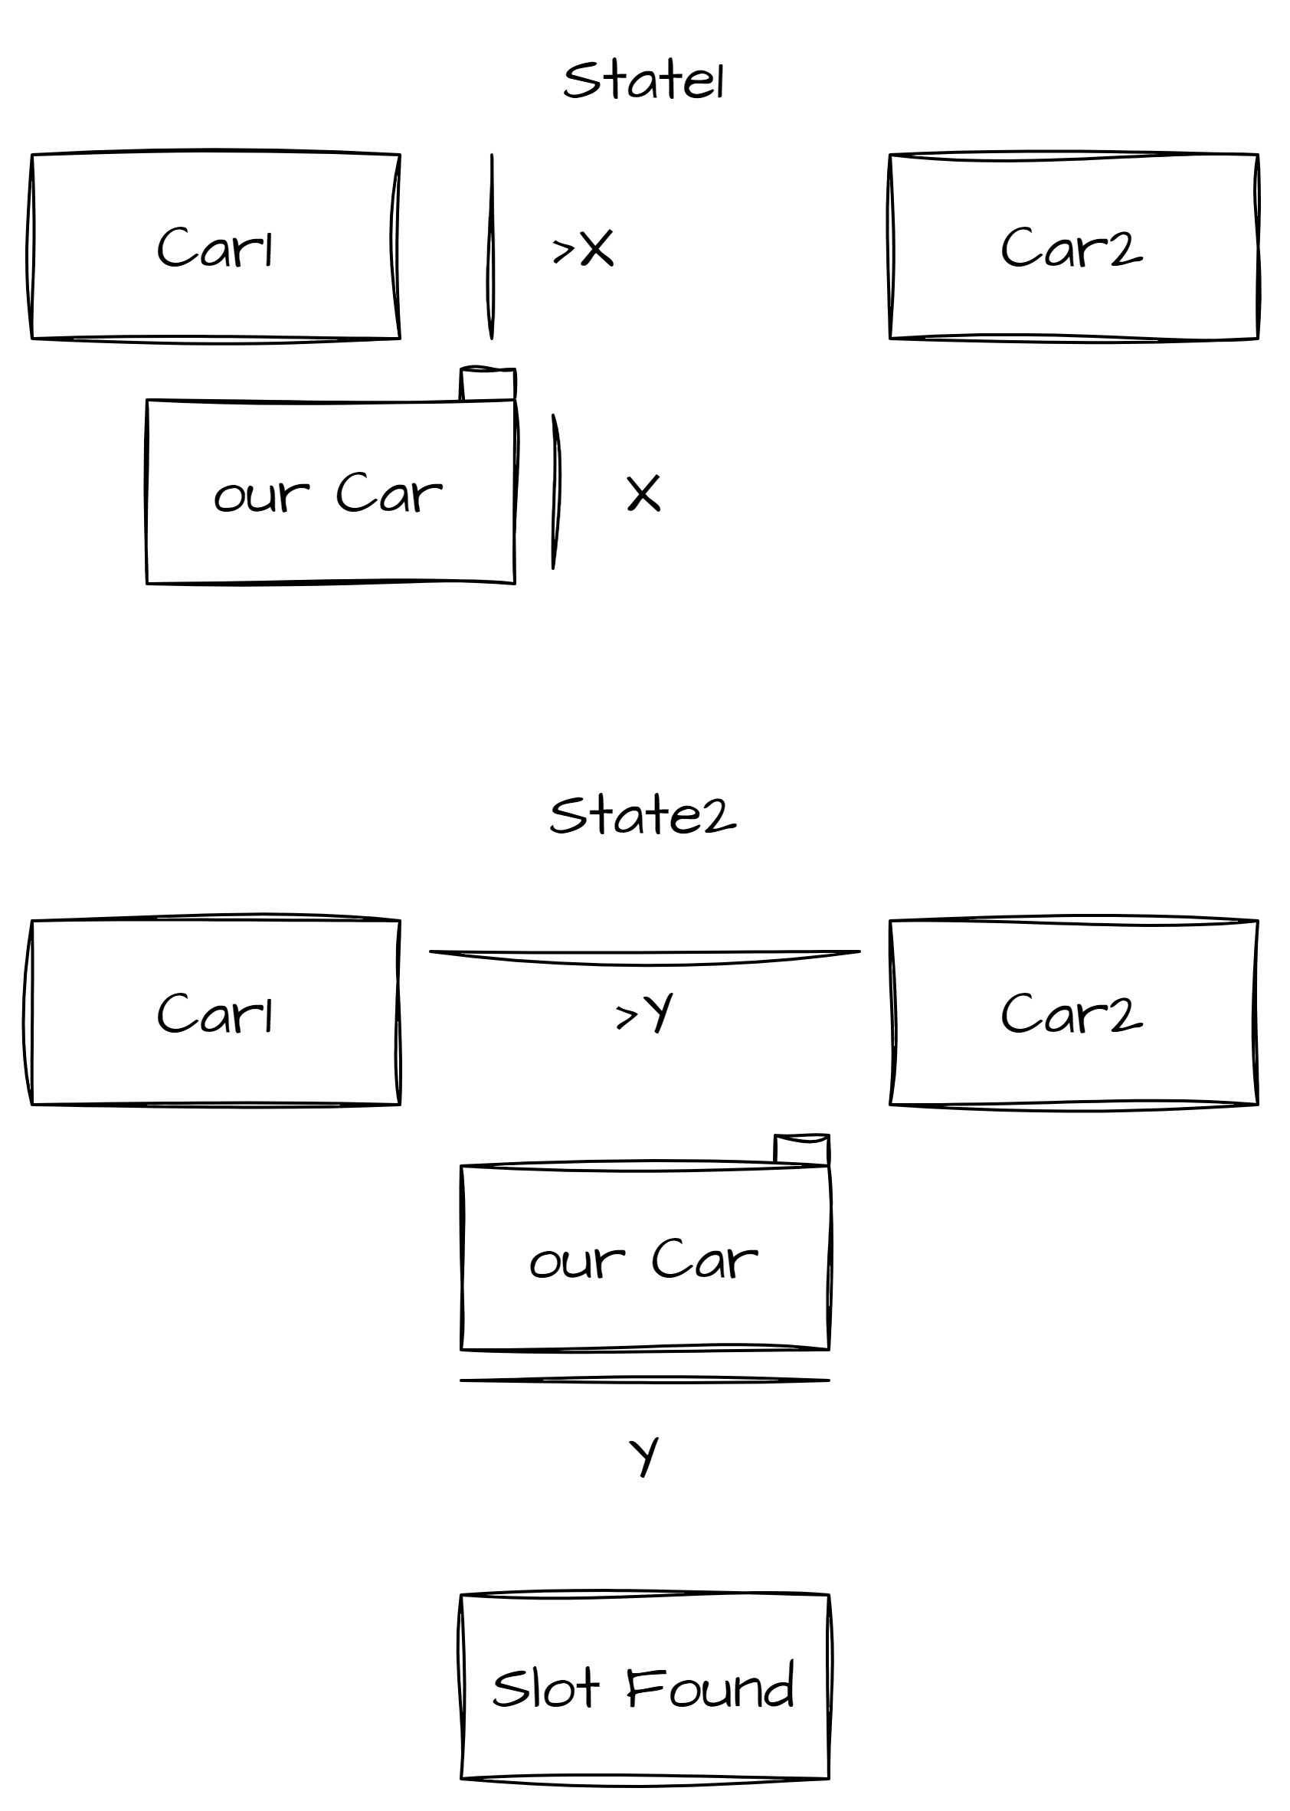
Detection Algorithm

Slide 9
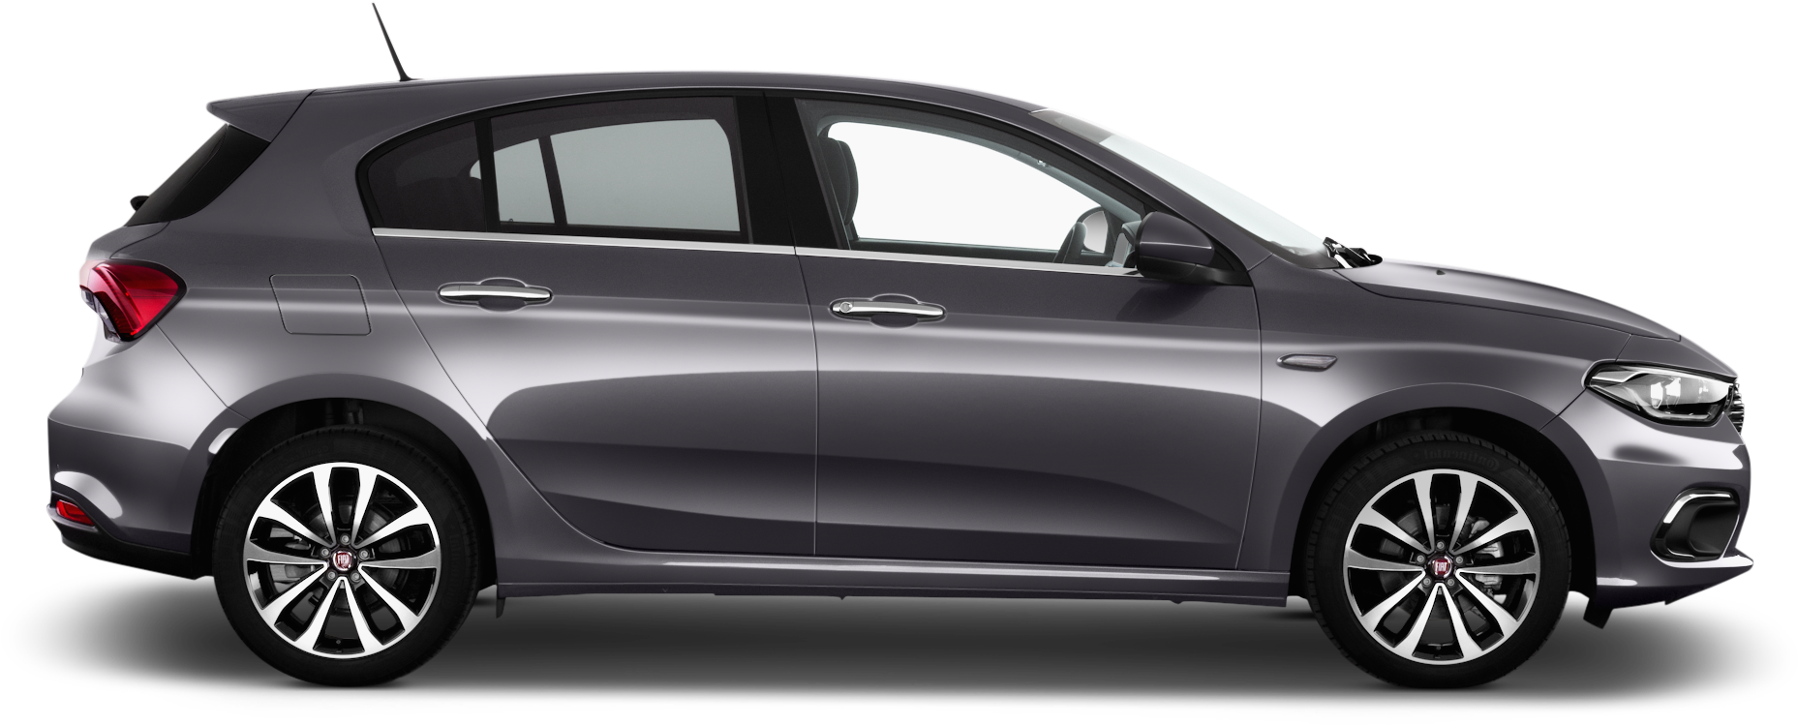
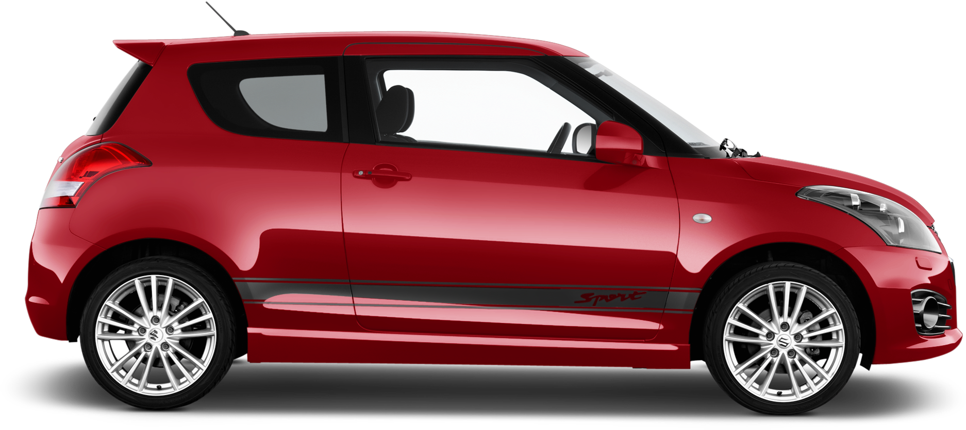
Detection Algorithm
>Y
>X
Empty Slot
X
Y

Slide 10
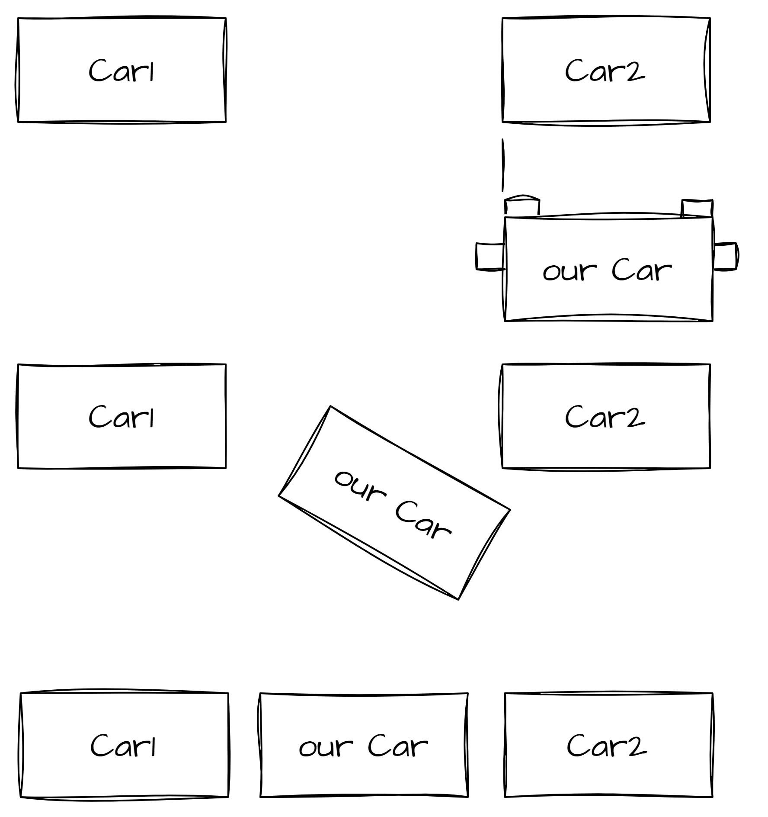
Parking Algorithm

Slide 11
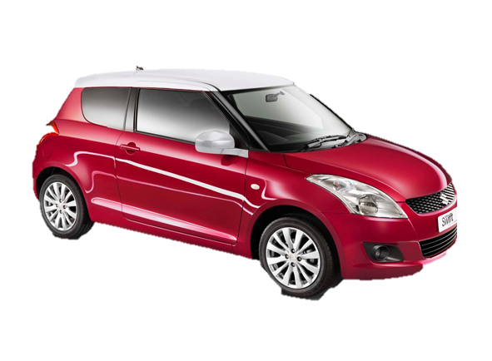
Parking Algorithm

Slide 12
Adjusting the Car Position

Slide 13
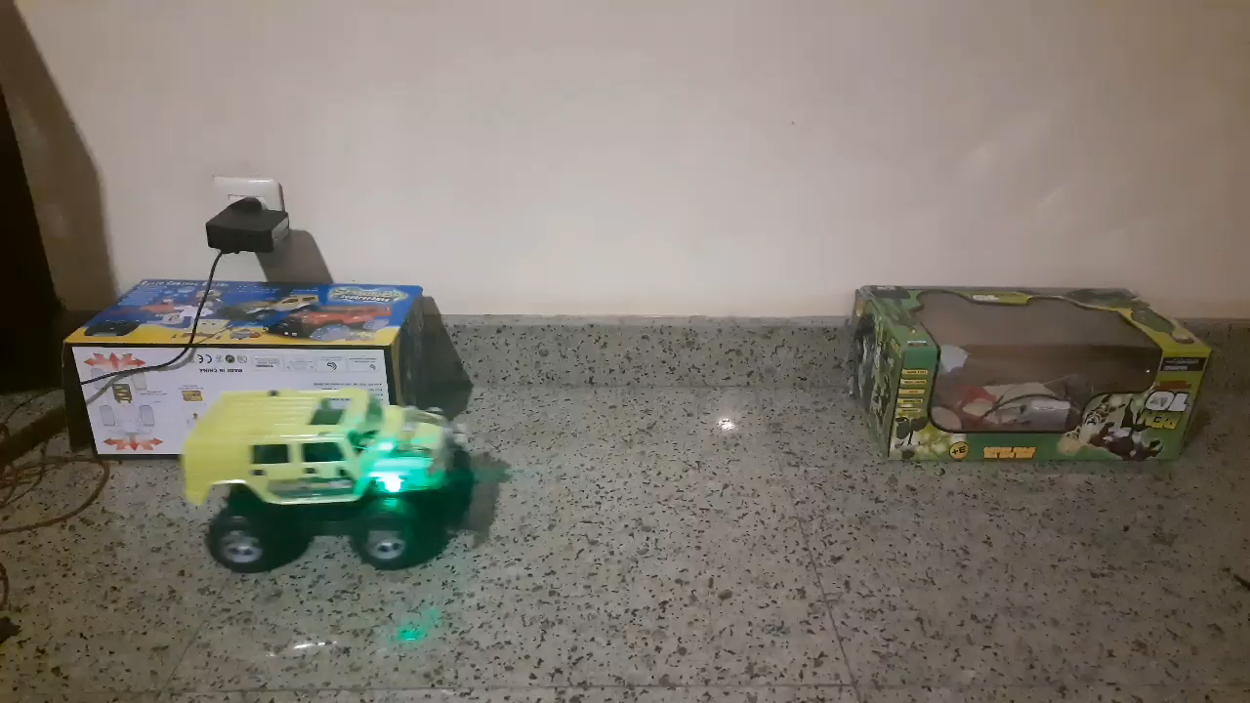

Slide 14
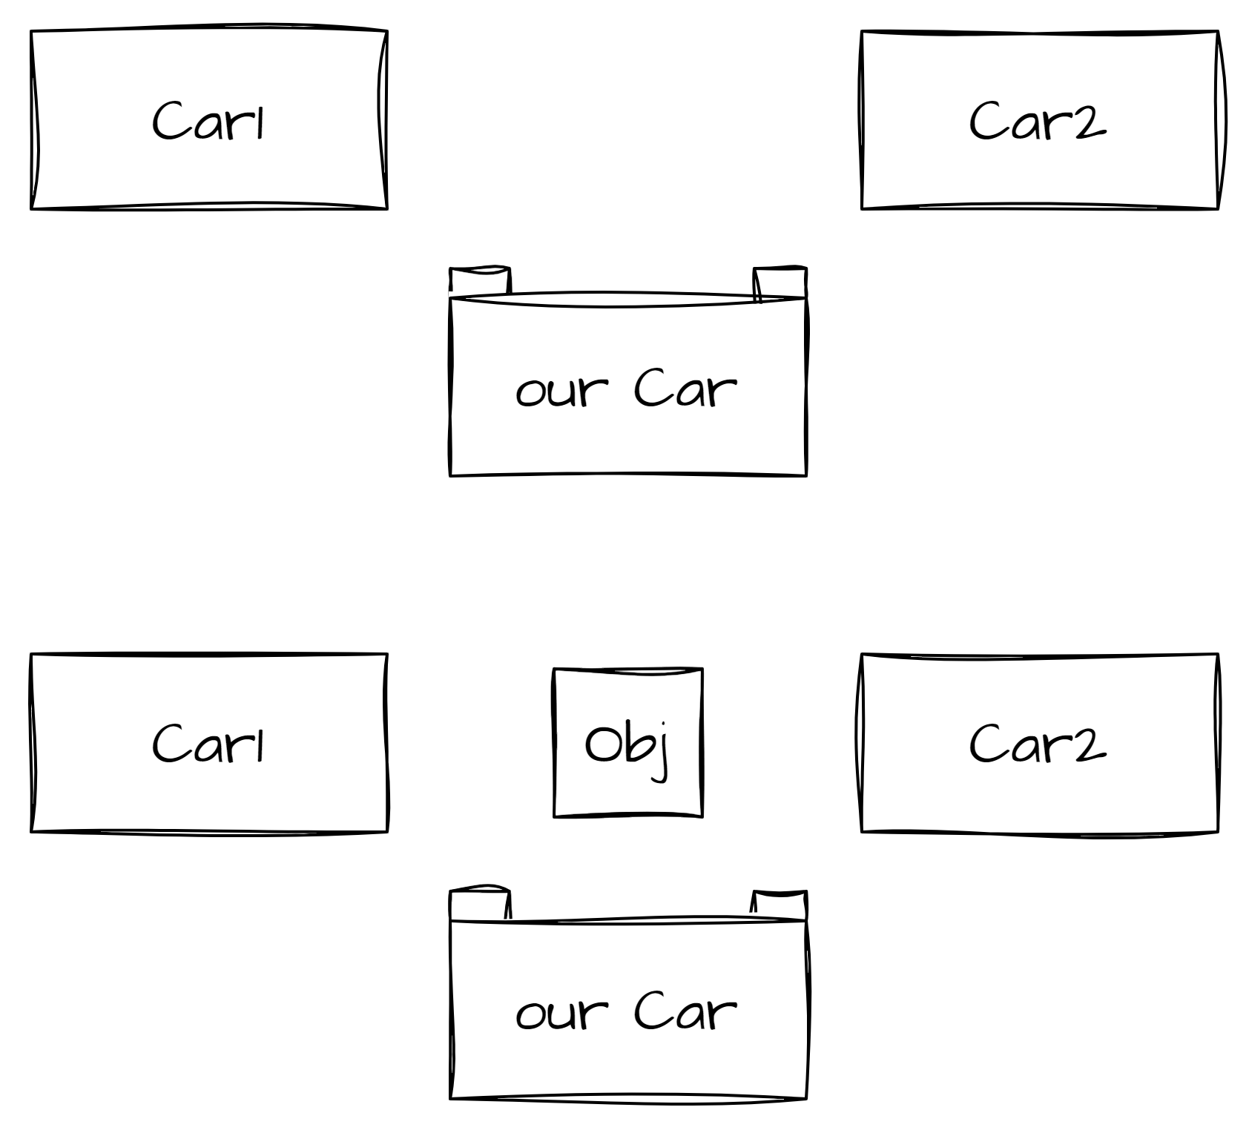
Suspension and Handling Problems

Slide 15
Suspension and Handling Problems
Obj
>X
>X
X

